Slide 1
Committee on Teaching about the UN
Poverty, Inequality and Social Justice
Thomas Pogge
Leitner Professor of Philosophy and International Affairs, Yale University
1
Notes:
1

Slide 2
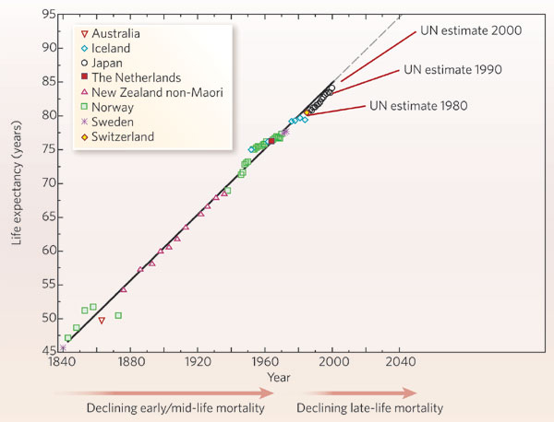
Life Expectancy at Birth

Slide 3
Life Expectancy at Birth
widely diverging, with Japan now at the top (about 83 years), the USA at about 50th place (about 78 years), and a few African countries — Swaziland, Angola, Mozambique, Zambia, Sierra Leone — at the bottom (about 40 years or even less).

Slide 4
Per Capita Income (Yr 2000 US$)
YEAR | 0 | 1000 | 1500 | 1820 | 1995
World | $425 | $420 | $545 | $675 | $5,188
The West | $439 | $406 | $624 | $1,149 | $19,990
West Europe | 450 | 400 | 670 | 1,269 | 17,456
N.America | 400 | 400 | 400 | 1,233 | 22,933
Japan | 400 | 425 | 525 | 675 | 19,720
The Rest | $423 | $424 | $532 | $594 | $2,971
Other Europe | 400 | 400 | 597 | 803 | 5,147
Latin America | 400 | 415 | 415 | 671 | 5,031
China | 450 | 450 | 600 | 600 | 2,653
Other Asia | 425 | 425 | 525 | 560 | 2,768
Africa | 400 | 400 | 400 | 400 | 1,221

Slide 5
The Human Right Least Realized
“Everyone has the right to a standard of living adequate for the health and well-being of himself and of his family, including food, clothing, housing and medical care and necessary social services….”
Article 25(1), Universal Declaration of Human Rights, 1948
5
5
Notes:
5
5

Slide 6
World Poverty Today
Among 7+ billion human beings, about
868 million are chronically undernourished (FAO 2012),
2000 million lack access to essential medicines (www.fic.nih.gov/about/plan/exec_summary.htm),
783 million lack safe drinking water (MDG Report 2012, p. 52),
1600 million lack adequate shelter (UN Special Rapporteur 2005),
1600 million lack electricity (UN Habitat, “Urban Energy”),
2500 million lack adequate sanitation (MDG Report 2012, p. 5),
796 million adults are illiterate (www.uis.unesco.org),
218 million children (aged 5 to 17) do wage work outside their household — often under slavery-like and hazardous conditions: as soldiers, prostitutes or domestic servants, or in agriculture, construction, textile or carpet production. ILO: The End of Child Labour, Within Reach, 2006, pp. 9, 11, 17-18.
6
Notes:
6

Slide 7
Quintiles as defined by Snapshot View | Life-expectancy | Group Size as Defined by Whole-Person View
Poorest 20% | 36 years | 34%
Second-poorest 20% | 60 years | 20%
Middle 20% | 72 years | 17%
Second-richest 20% | 80 years | 15%
Richest 20% | 84 years | 14%
Over a third of all lives lived in the poorest fifth of humanity?

Slide 8
At Least a Third of Human Deaths
— some 18 (out of 57) million per year or 50,000 daily — are due to poverty-related causes, in thousands:
diarrhea (2163) and malnutrition (487),
perinatal (3180) and maternal conditions (527),
childhood diseases (847 — half measles),
tuberculosis (1464), meningitis (340), hepatitis (159),
malaria (889) and other tropical diseases (152),
respiratory infections (4259 — mainly pneumonia),
HIV/AIDS (2040), sexually transmitted diseases (128).
WHO: World Health Organization, Global Burden of Disease: 2004 Update, Geneva 2008, Table A1, pp. 54-59.

Slide 9
Millions of Deaths
9
Notes:
9

Slide 10
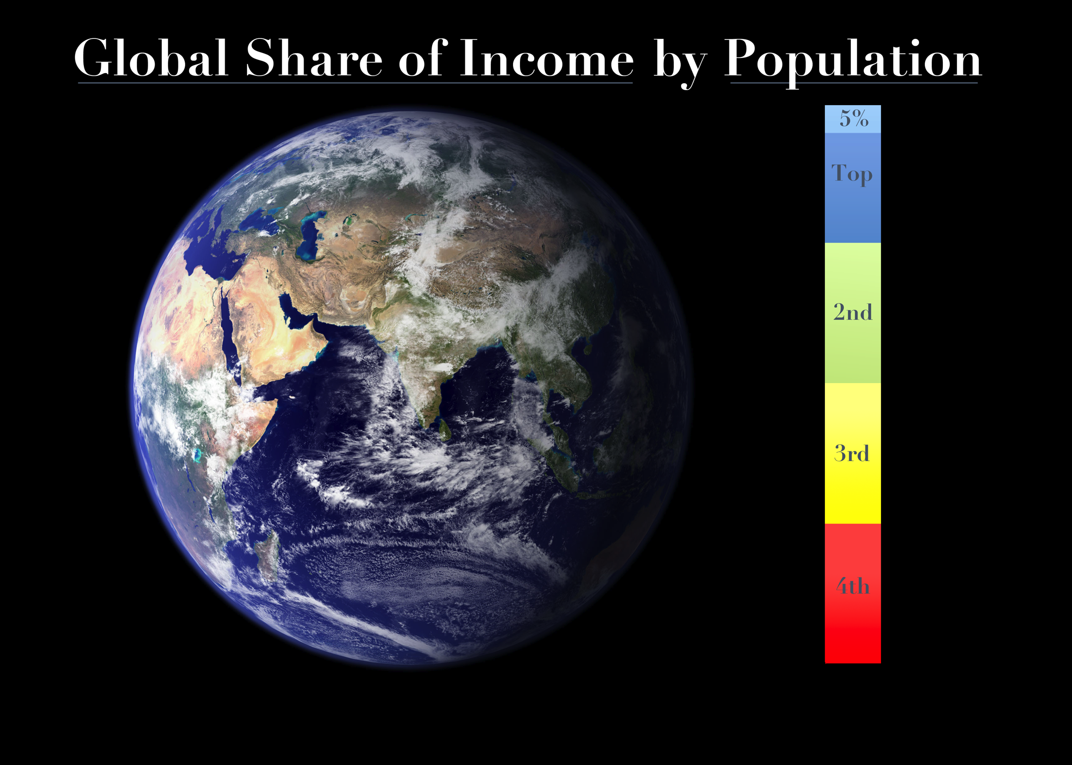

Slide 11
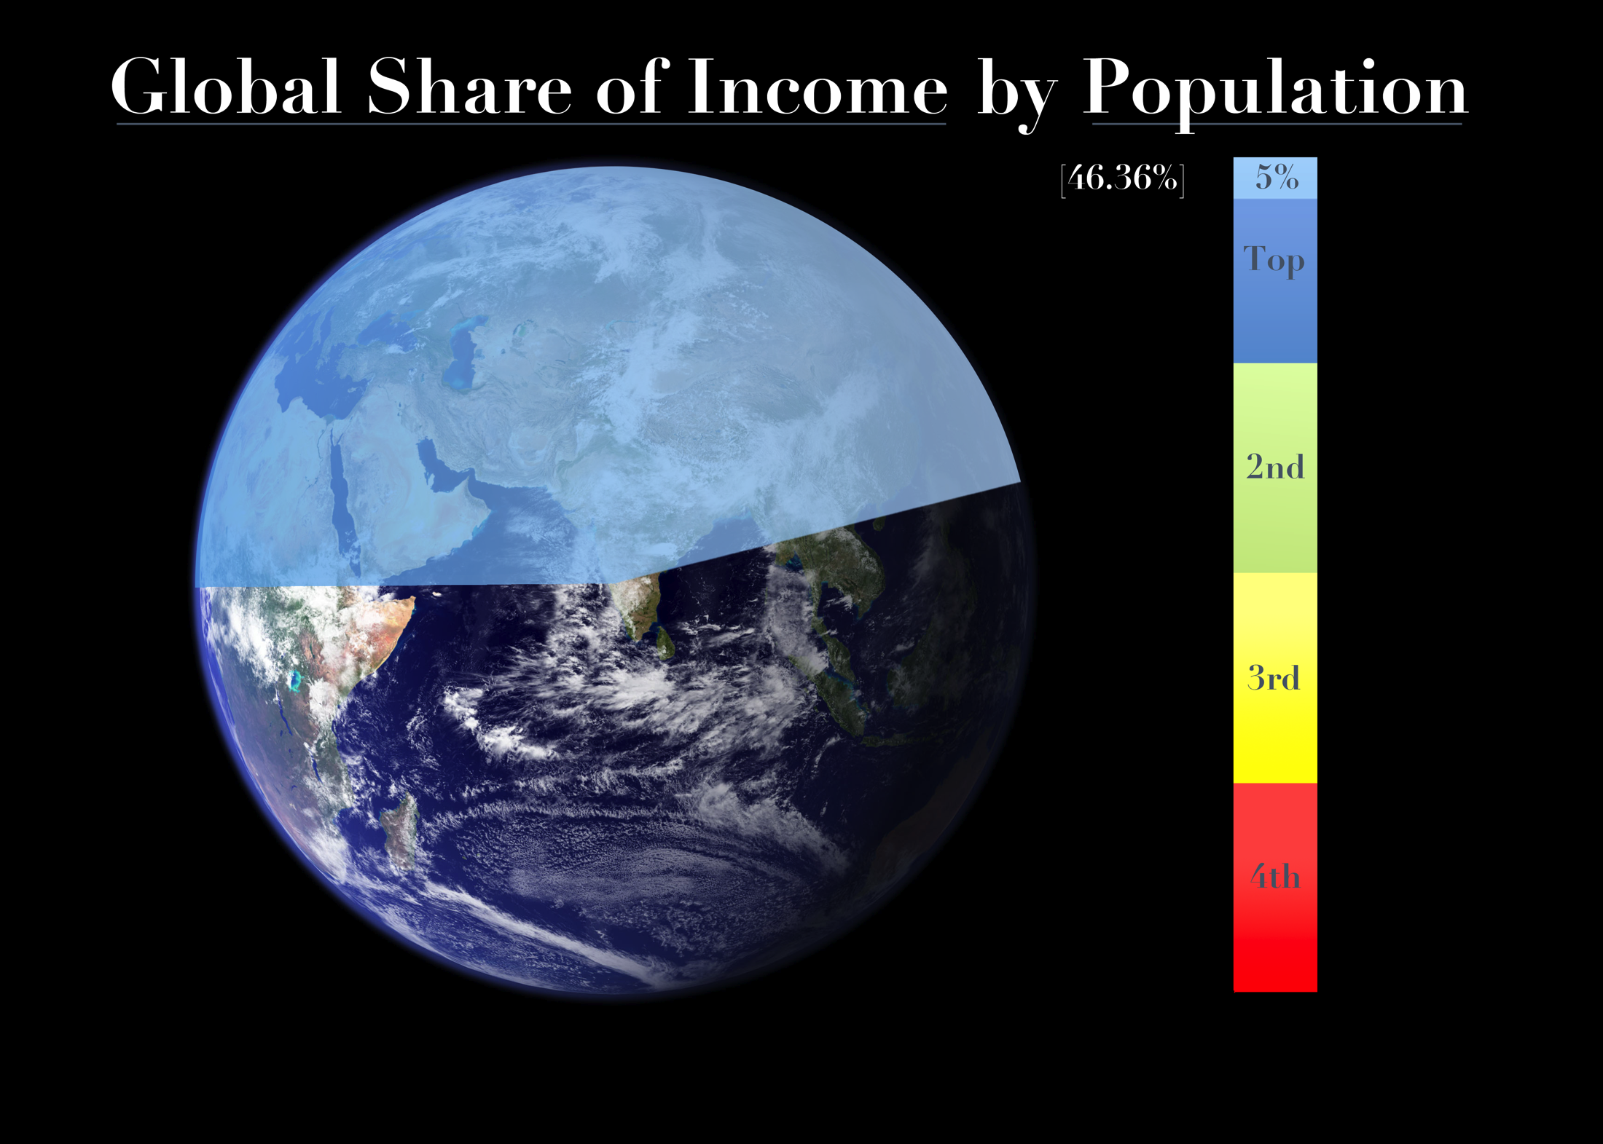

Slide 12
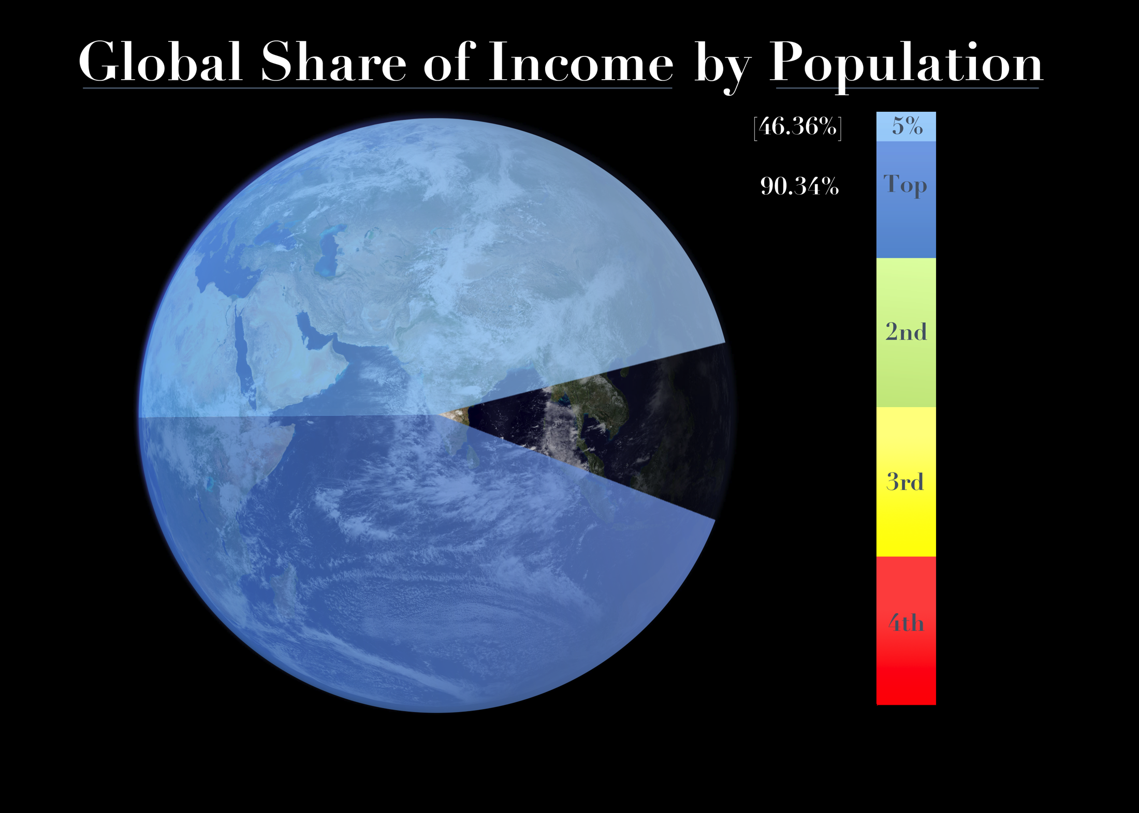

Slide 13
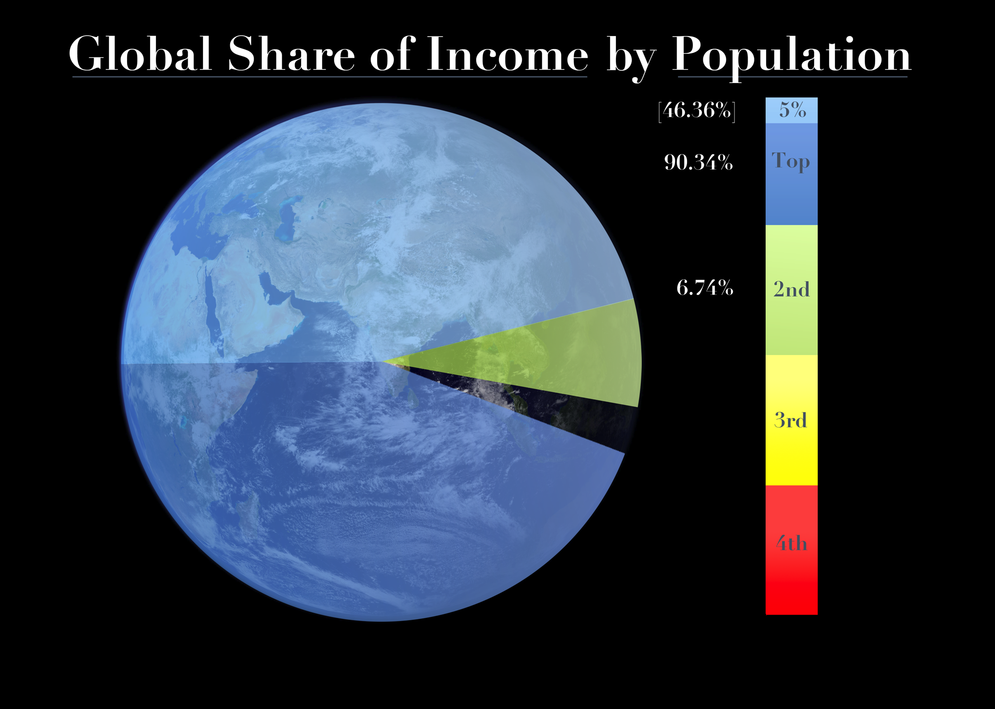

Slide 14
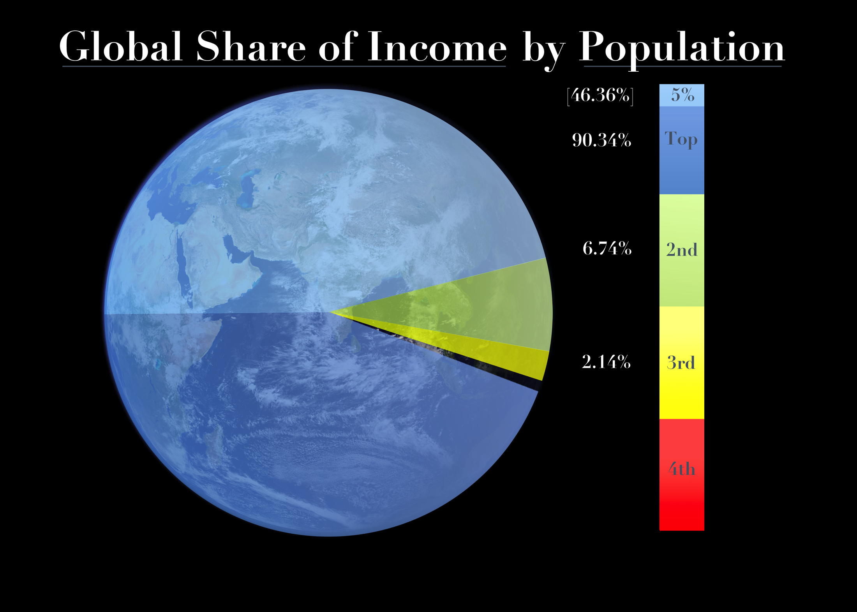

Slide 16
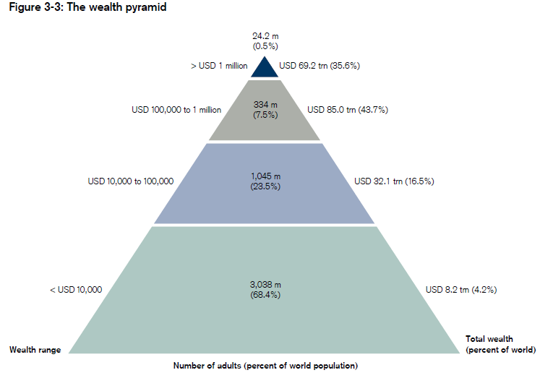
Wealth

Slide 17
Global Household Income Distribution 1988
Richest Ventile: 42.87%
Top Five Percent 42.87%
Next Twenty Percent 46.63%
Second Quarter 6.97%
1.16%
2.37%
Data Branko Milanovic, World Bank

Slide 18
Global Household Income Distribution 2005
Richest Ventile: 42.87%
Top Five Percent 46.36%
Next Twenty Percent 43.98%
Second Quarter 6.74%
0.78%
2.14%
Data Branko Milanovic, World Bank

Slide 19
Key Facts
In just 17 years, the richest five percent of human beings have gained more (3.49%) than the poorer half had left at the end of this period (2.92%).
The ratio of average incomes of the richest five percent and the poorest quarter rose from 185:1 to 297:1 in this 1988-2005 period.
Had the poorer half held steady, its 2005 share of global household income would have been 21% higher (3.53% instead of 2.92%).
Had the poorest quarter held steady, its 2005 share of global household income would have been 49% higher (1.16% instead of 0.78%).
Had it been allowed to gain the 3.49% of global household income that was in fact gained by the richest five percent, the poorer half would have doubled its share to 7.02% in 2005 — sufficient to end severe poverty.
19

Slide 20
Inequality Spirals
Regulatory capture makes competitive systems vulnerable to inequality spirals:
The strongest participants have the greatest opportunities and incentives to achieve the expertise and coordination needed for effective lobbying.
They use these opportunities to expand their relative position; then use their increased influence to shift the rules or their application even more in their own favor.
20

Slide 21
Supranational Rule Shaping
offers especially high returns from lobbying because such rules emerge in a bargaining environment where
there is no democratic counterweight or
revolutionary danger zone,
there is little transparency even ex post,
and moral restraints are easily dispelled by
doubts about their international acceptance.
21

Slide 22
The Most Cost-Effective Lobbying
seeks to shape the design of supranational/global institutional arrangements (WTO, G20, EU…)
while also aiming to shift governance upward from the national to the supranational/global level;
is done by the very wealthiest banks, corporations, industry associations and individuals
by way of influencing government officials of major powers, esp. the US (softest target).
22

Slide 23
Counter-Argument
Poverty is evolving differently in the various developing countries and regions.
This shows that local (e.g., municipal, provincial, national) factors account for the persistence of severe poverty where it persist.
23

Slide 24
Conceptual Answer to the Counter-Argument
It merely shows that local factors are co-responsible for the persistence of severe poverty. It does not show that local factors are solely responsible.
Example: Differential learning success of students/pupils in the same class.
24

Slide 25
Rising Inequality in the US (1978-2007)
The income share of the poorest half of the population dropped
by more than half from 26.4% to 12.8%. That of the top 1 percent
rose 2.6-fold from 8.95% to 23.50%; that of the top 1/10 percent
rose 4.6-fold from 2.65% to 12.28%; that of the top 1/100 percent
rose 7-fold from 0.86% to 6.04% (Saez Table A3).
The top hundredth percent (14,400 tax returns, ca. 30,000 people) have nearly half as much income as the bottom half (ca. 150 million) of Americans — and more income than the bottom 40% (2800 million) of humanity.
finance.yahoo.com/banking-budgeting/article/107575/rise-of-the-super-rich-hits-a-sobering-wall.html
25

Slide 26
Supranational Institutional Architecture
 |  | National Institutional Schemes of the Various Less Developed Countries
 |  | Poor and Vulnerable Citizens in the Less Developed Countries
26
Notes:
26

Slide 27
Supranational Institutional Architecture
Protectionism
 |  | National Institutional Schemes of the Various Less Developed Countries
 |  | Poor and Vulnerable Citizens in the Less Developed Countries
27
Notes:
27

Slide 28
Supranational Institutional Architecture
Protectionism
Pollution Rules
 |  | National Institutional Schemes of the Various Less Developed Countries
 |  | Poor and Vulnerable Citizens in the Less Developed Countries
28
Notes:
28

Slide 29
Supranational Institutional Architecture
Protectionism
Pollution Rules
Pharmaceuticals
 |  | National Institutional Schemes of the Various Less Developed Countries
 |  | Poor and Vulnerable Citizens in the Less Developed Countries
29
Notes:
29

Slide 30
Supranational Institutional Architecture
Protectionism
Pollution Rules
Pharmaceuticals
Illicit Financial Flows
 |  | National Institutional Schemes of the Various Less Developed Countries
 |  | Poor and Vulnerable Citizens in the Less Developed Countries
30
Notes:
30

Slide 31
Supranational Institutional Architecture
Protectionism
Pollution Rules
Pharmaceuticals
Illicit Financial Flows
Labor Standards
 |  | National Institutional Schemes of the Various Less Developed Countries
 |  | Poor and Vulnerable Citizens in the Less Developed Countries
Nat’l Violence, Oppression, Exploitation, Corruption
31
Notes:
31

Slide 32
Supranational Institutional Architecture
Protectionism
Pollution Rules
Pharmaceuticals
Illicit Financial Flows
Labor Standards
Four Privileges
 |  | National Institutional Schemes of the Various Less Developed Countries
 |  | Poor and Vulnerable Citizens in the Less Developed Countries
Nat’l Violence, Oppression, Exploitation, Corruption
32
Notes:
32

Slide 33
Supranational Institutional Architecture
Protectionism
Pollution Rules
Pharmaceuticals
Illicit Financial Flows
Labor Standards
Four Privileges
Arms Trade
 |  | National Institutional Schemes of the Various Less Developed Countries
 |  | Poor and Vulnerable Citizens in the Less Developed Countries
Nat’l Violence, Oppression, Exploitation, Corruption
33
Notes:
33

Slide 34
Supranational Institutional Architecture
Protectionism
Pollution Rules
Pharmaceuticals
Illicit Financial Flows
Labor Standards
Four Privileges
Arms Trade
Governments of the More Powerful Countries |  | National Institutional Schemes of the Various Less Developed Countries
 |  | Poor and Vulnerable Citizens in the Less Developed Countries
Nat’l Violence, Oppression, Exploitation, Corruption
34
Notes:
34

Slide 35
Supranational Institutional Architecture
Protectionism
Pollution Rules
Pharmaceuticals
Illicit Financial Flows
Labor Standards
Four Privileges
Arms Trade
Governments of the More Powerful Countries |  | National Institutional Schemes of the Various Less Developed Countries
Corporations and Citizens of the More Powerful Countries |  | Poor and Vulnerable Citizens in the Less Developed Countries
Nat’l Violence, Oppression, Exploitation, Corruption
35
Notes:
35

Slide 36
Human Rights as Moral Claims on (Global) Institutional Arrangements
“Everyone is entitled to a social and international order in which the rights and freedoms set forth in this Declaration can be fully realized.”
Article 28, Universal Declaration of Human Rights, 1948
36
Notes:
36

Slide 37
Reform Prospects
My generation has failed at protecting the poor – domestically and esp. internationally.
As a result, run-away inequality has become entrenched, reform much harder to achieve.
Attaining real participation by the poor is still possible through sustained moral mobilization sharply focused on intelligent political action that includes allies who may not be morally motivated.
37

Slide 38
The Core Challenge for Reform
Increasing importance of supranational institutional arrangements (WTO, G20, EU…);
democratic deficit, associated with enhanced opportunities for regulatory capture;
inequality spiral and inefficiency/instability of supranational institutional architecture (GFC).

Slide 39
The Millennium Development “Goals”
Move from
a detached wish list
to
specific responsibilities of named competent actors
39

Slide 40
Post-2015 Institutional Reform Goals
Tax on trade-distorting subventions for poverty eradication
Tax on greenhouse gas emissions for poverty eradication
Tax on arms exports to LDCs for poverty eradication
Alternative Minimum Tax on MNC profits for poverty eradication
End accounts with unknown owners or beneficiaries
Only minimally representative rulers to undertake debt burdens
Tax on natural resource purchases from unrepresentative rulers
Option to have new medicines rewarded according to health impact
40

