Slide 1
Modern Slavery Around the World
By Ngwansi Nji
Baruch College
Graduate School of Public Affairs

Slide 2
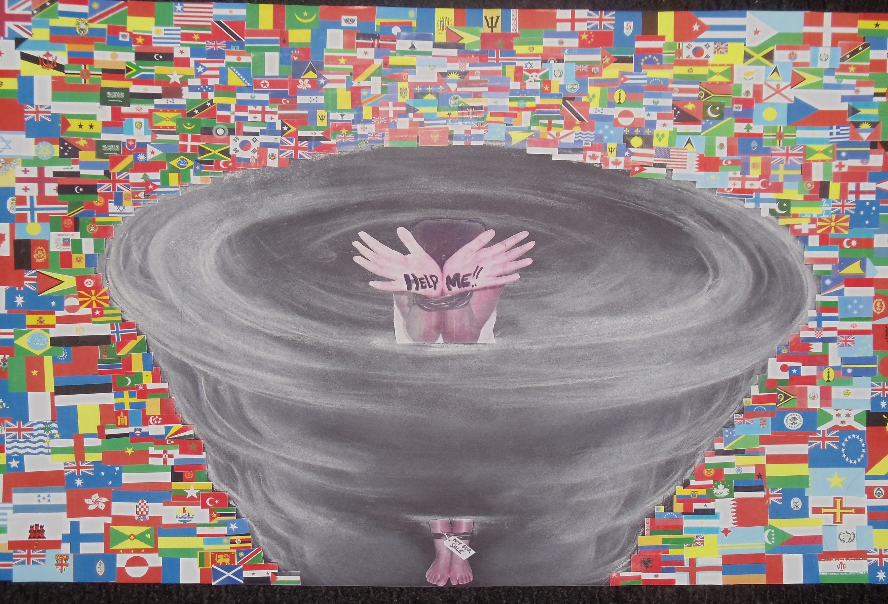

Slide 3
